Slide 1
Differential Equations
Substitution for First and Second ORDER

Slide 2
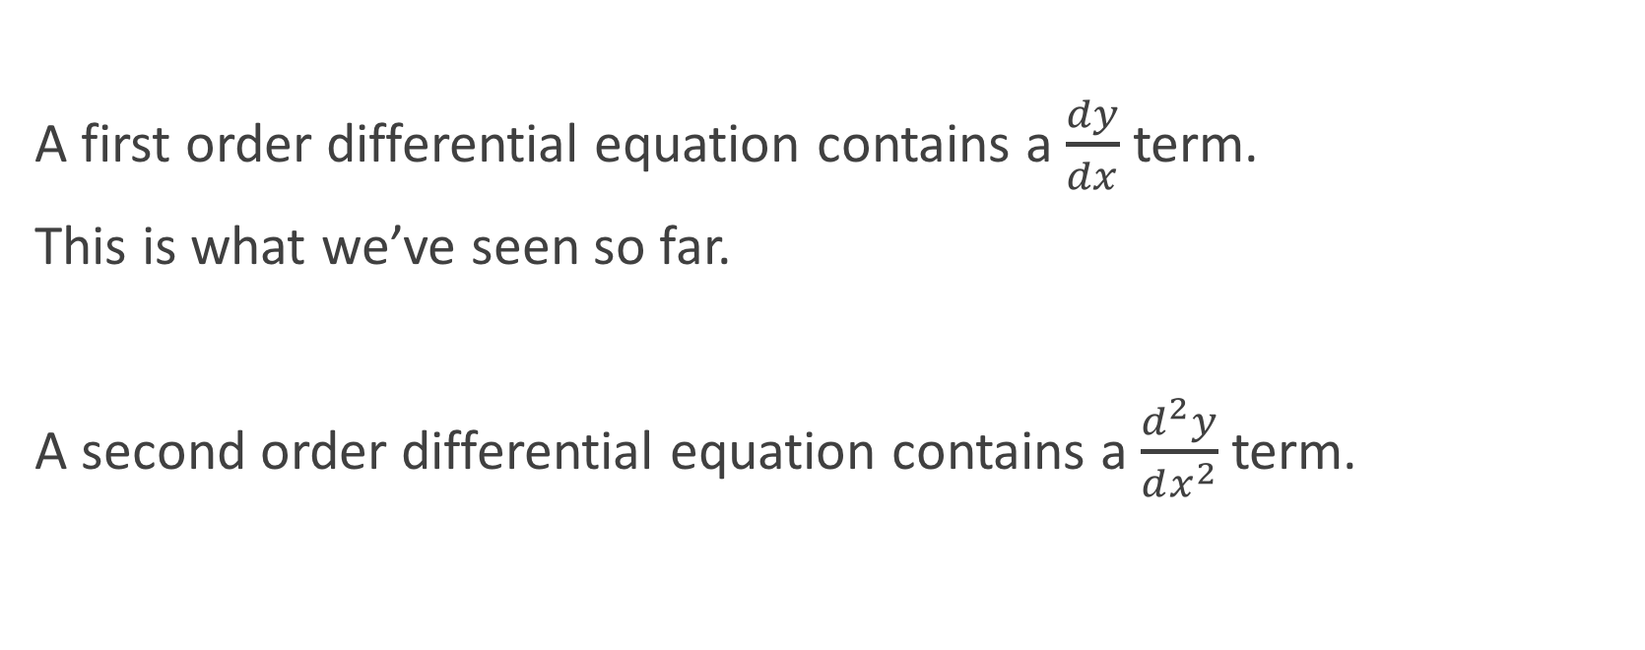
First Order vs Second Order
A first order differential equation contains a $\frac{dy}{dx}$ term.
This is what we’ve seen so far.
A second order differential equation contains a $\frac{d^{2}y}{dx^{2}}$ term.

Slide 3
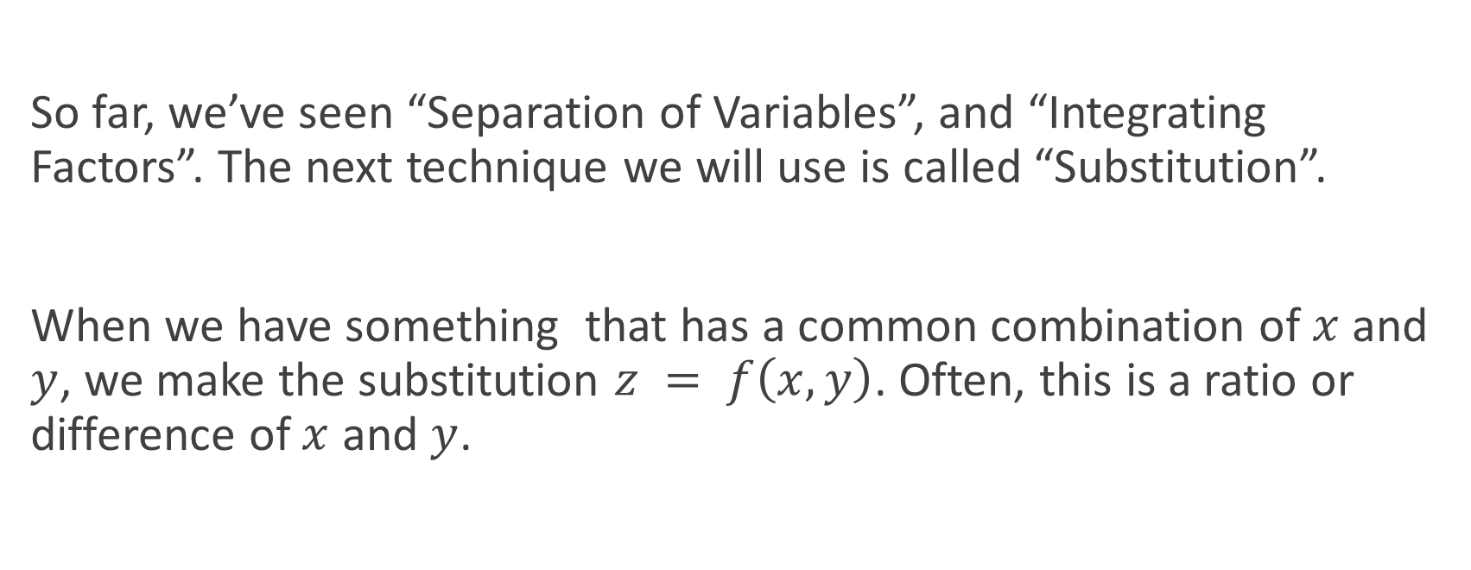
Substitution
So far, we’ve seen “Separation of Variables”, and “Integrating Factors”. The next technique we will use is called “Substitution”.
When we have something that has a common combination of $x$ and $y$, we make the substitution $z = f\left(x, y\right)$. Often, this is a ratio or difference of $x$ and $y$.

Slide 4
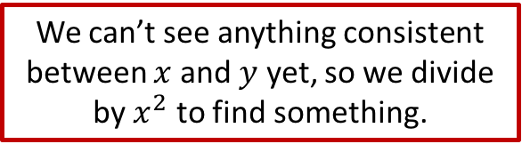
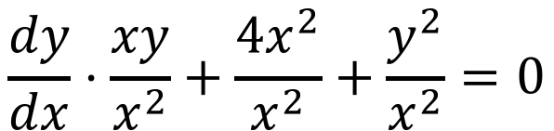
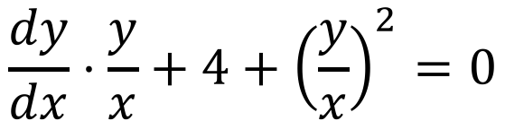
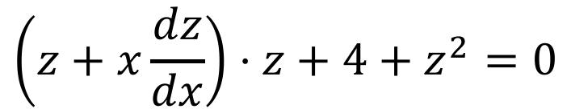
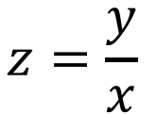
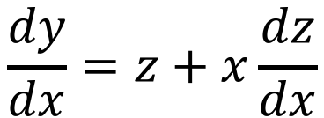

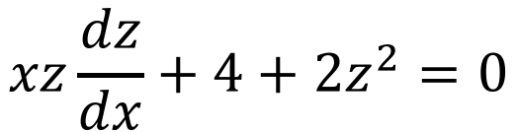
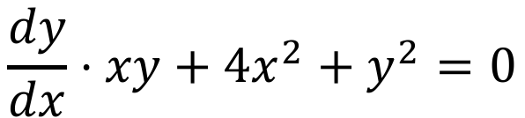
Example
We can’t see anything consistent between $x$ and $y$ yet, so we divide by $x^{2}$ to find something.
$$\frac{dy}{dx}⋅xy+4x^{2}+y^{2}=0$$
$$\frac{dy}{dx}⋅\frac{xy}{x^{2}}+\frac{4x^{2}}{x^{2}}+\frac{y^{2}}{x^{2}}=0$$
$$\frac{dy}{dx}⋅\frac{y}{x}+4+{\left(\frac{y}{x}\right)}^{2}=0$$
$$z=\frac{y}{x}$$
$$\frac{dy}{dx}=z+x\frac{dz}{dx}$$
$$y=xz$$
$$\left(z+x\frac{dz}{dx}\right)⋅z+4+z^{2}=0$$
$$xz\frac{dz}{dx}+4+2z^{2}=0$$

Slide 5
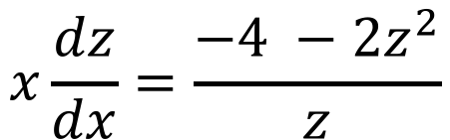
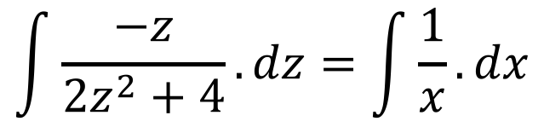
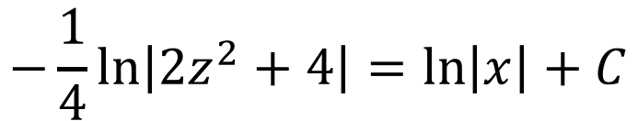
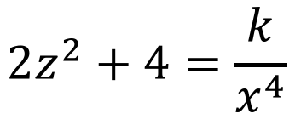
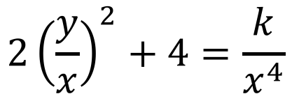
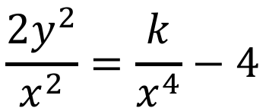
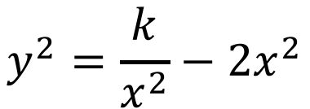
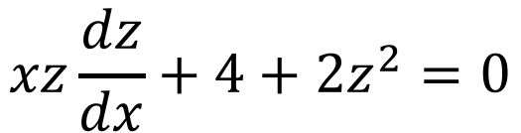
Example
I didn’t give you initial conditions, so we are, in fact, done! Yay!
$$xz\frac{dz}{dx}+4+2z^{2}=0$$
$$2z^{2}+4=\frac{k}{x^{4}}$$
$$x\frac{dz}{dx}=\frac{−4 −2z^{2}}{z}$$
$$2{\left(\frac{y}{x}\right)}^{2}+4=\frac{k}{x^{4}}$$
$$\int{\frac{−z}{2z^{2}+4}.dz}=\int{\frac{1}{x}.dx}$$
$$\frac{2y^{2}}{x^{2}}=\frac{k}{x^{4}}−4$$
$$−\frac{1}{4}\ln\left|2z^{2}+4\right|=\ln\left|x\right|+C$$
$$y^{2}=\frac{k}{x^{2}}−2x^{2}$$

Slide 6

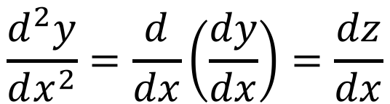
Substitution for Second Order
The second order differential equations we will consider are of a very special type: they contain only $x$ terms, or they contain only $y$ terms.
We use a very specific substitution, $z=\frac{dy}{dx}$, and the following identity:
$$\frac{d^{2}y}{dx^{2}}=\frac{d}{dx}\left(\frac{dy}{dx}\right)=\frac{dz}{dx}$$

Slide 7
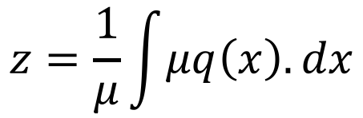
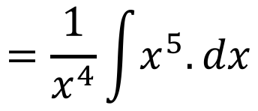
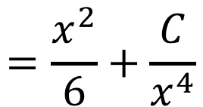
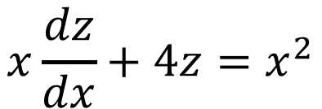
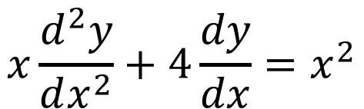
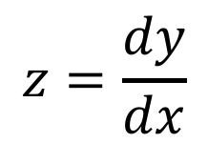
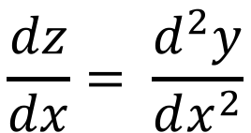
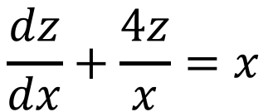

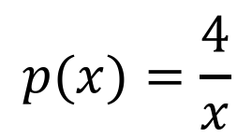



Example 1
This equation cannot be separated, so we have to use an integrating factor.
$$x\frac{d^{2}y}{dx^{2}}+4\frac{dy}{dx}=x^{2}$$
$$z=\frac{dy}{dx}$$
$$\frac{dz}{dx}= \frac{d^{2}y}{dx^{2}}$$
$$x\frac{dz}{dx}+4z=x^{2}$$
$$\frac{dz}{dx}+\frac{4z}{x}=x$$
$$p(x)=\frac{4}{x}$$
$$q(x)=x$$
$$μ=e^{\int{p\left(x\right).dx}}$$
$$μ=e^{4\ln{x}}$$
$$=x^{4}$$
$$z=\frac{1}{μ}\int{μq\left(x\right).dx}$$
$$=\frac{1}{x^{4}}\int{x^{5}.dx}$$
$$=\frac{x^{2}}{6}+\frac{C}{x^{4}}$$

Slide 8
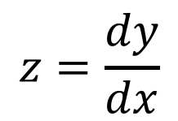
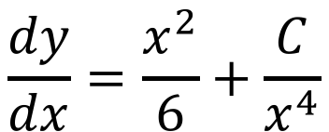
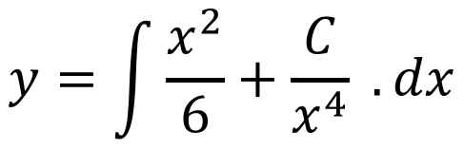
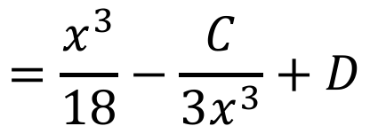
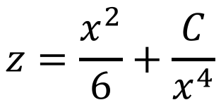
Example 1
Notice we have two constants of integration, which is normal for 2nd order DEs. Normally, we would be given two conditions to use to find them.
$$z=\frac{x^{2}}{6}+\frac{C}{x^{4}}$$
$$z=\frac{dy}{dx}$$
$$\frac{dy}{dx}=\frac{x^{2}}{6}+\frac{C}{x^{4}}$$
$$y=\int{\frac{x^{2}}{6}+\frac{C}{x^{4}} .dx}$$
$$=\frac{x^{3}}{18}−\frac{C}{3x^{3}}+D$$

Slide 9
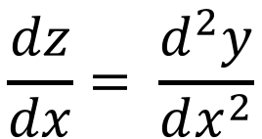
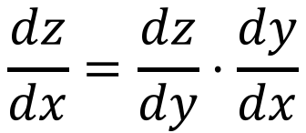
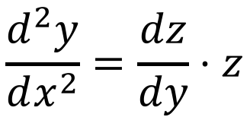
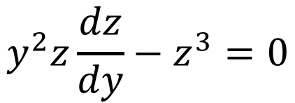
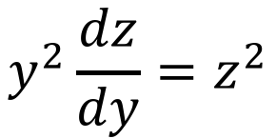
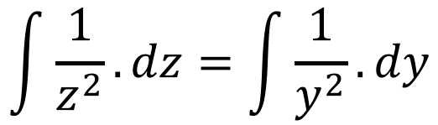
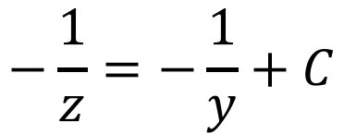
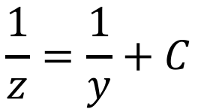
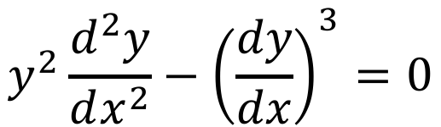
Example 2
$$y^{2}\frac{d^{2}y}{dx^{2}}−{\left(\frac{dy}{dx}\right)}^{3}=0$$
$$z=\frac{dy}{dx}$$
$$\frac{dz}{dx}= \frac{d^{2}y}{dx^{2}}$$
$$\frac{dz}{dx}=\frac{dz}{dy}⋅\frac{dy}{dx}$$
$$y^{2}z\frac{dz}{dy}−z^{3}=0$$
$$\frac{d^{2}y}{dx^{2}}=\frac{dz}{dy}⋅z$$
$$y^{2}\frac{dz}{dy}=z^{2}$$
$$\int{\frac{1}{z^{2}}.dz}=\int{\frac{1}{y^{2}}.dy}$$
$$−\frac{1}{z}=−\frac{1}{y}+C$$
$$\frac{1}{z}=\frac{1}{y}+C$$

Slide 10
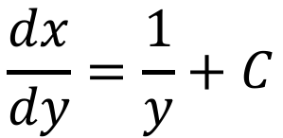
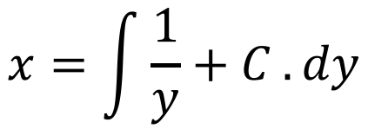

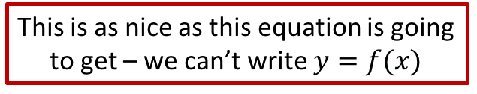
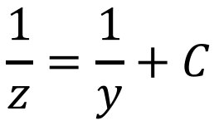
Example 2
This is as nice as this equation is going to get – we can’t write $y=f(x)$
$$\frac{1}{z}=\frac{1}{y}+C$$
$$z=\frac{dy}{dx}$$
$$\frac{dx}{dy}=\frac{1}{y}+C$$
$$x=\int{\frac{1}{y}+C .dy}$$
$$=\ln\left|y\right|+Cy+D$$

Slide 11
Do Now
Any Questions?
Delta Workbook
Nothing this time.
Workbook
Pages 194-197, 201-203

Slide 12

This work is licensed under a Creative Commons Attribution-NonCommercial-ShareAlike 4.0 International License.
Aaron Stockdill
2016

